Slide 1
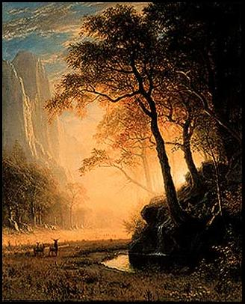
Warm-Up Activity
In the 1800s, many writers turned away from the harsh realities of industrial life to celebrate nature. The English poet William Wordsworth described the peace and beauty of sunset:
“It is a beauteous evening, calm and free,
The Holy time is quiet as a Nun
Breathless with adoration; the broad sun
Is sinking down in its tranquility.”
--William Wordsworth,
Complete Poetical Works
Questions:
What is the main idea of the this stanza?
How is Wordsworth poem a reaction to industrial life?
Answers:
That the setting sun is calm, quiet, beautiful, and peaceful.
By retreating the beauty and power of nature, it turns away from the industrialization and city life.

Slide 2
Arts in the Industrial Age
From about 1750 to 1850, romanticism shaped Western literature and arts.

Slide 3
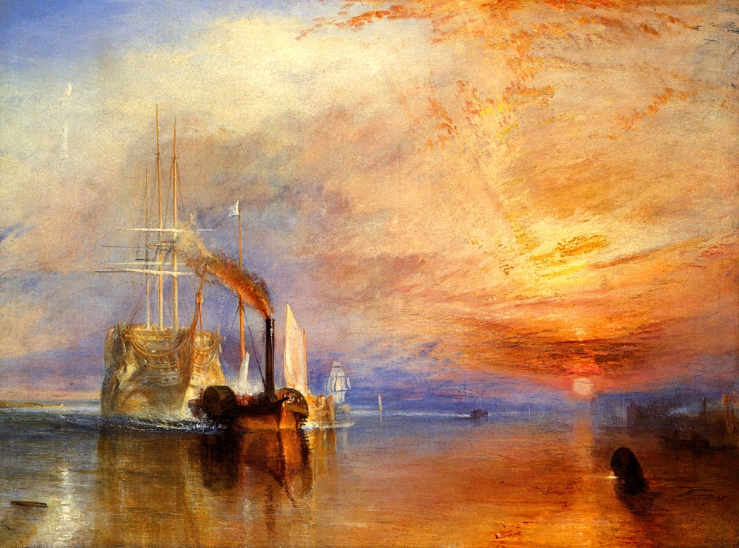
Romanticism
Does not refer to romance in the sense of an affectionate relationship, but rather to an artistic style emphasizing imagination, freedom, and emotion.
Reaction to the neoclassical writers of the Enlightenment.
Simple, direct language, intense feelings, and a glorification of nature.

Slide 4
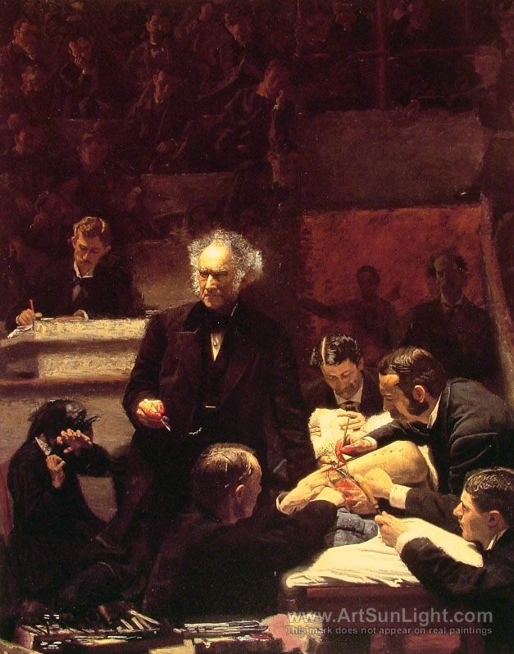
Realism
By the mid-1800s, a new artistic movement, realism, took hold in the West.
Focused on the harsh side of life in cities or villages.
Many writers and artists were committed to improving the lot of the unfortunates whose lives they depicted.
Charles Dickens – vividly portrayed the lives of slum dwellers and factory workers, including children. (A Tale of Two Cities; A Christmas Carol)
Victor Hugo – 1862 novel Les Miserables describes the reality of poverty, hunger, and corruption among the poor in Paris.
Thomas Eakin’s 1875 painting The Gross Clinic depicts the realism of medical school where students learn by performing autopsies.

Slide 5
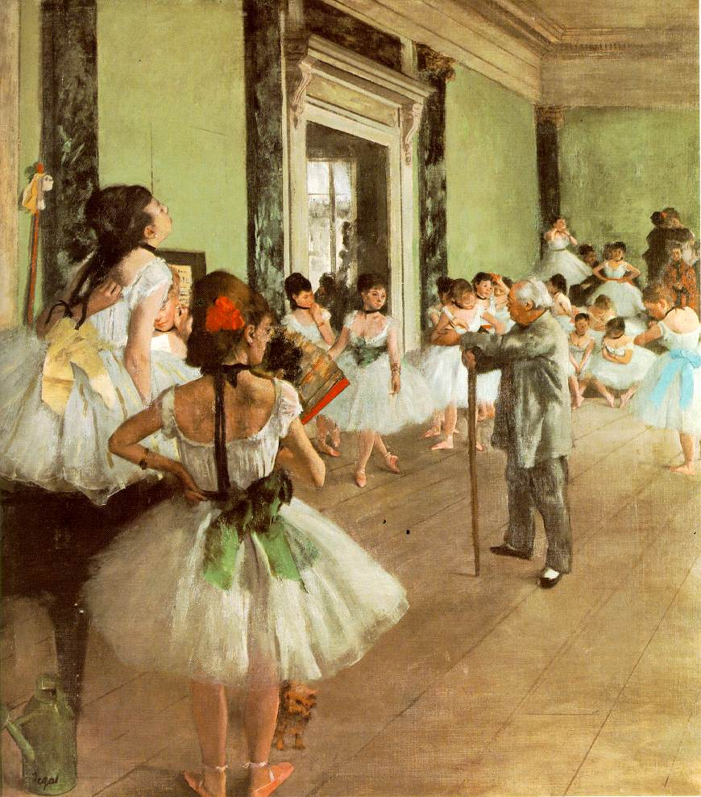
Impressionism
One of the most important art movements of the 1800s.
It marked a departure from tradition, both in subject matter and painting technique.
Artists sought to depict the human eye’s first perception of a scene.
Characterized by the use of unmixed primary colors and small, visible brush strokes, to show the effects of direct or reflected light.
Artists often painted outdoors for maximum effect.

Slide 6
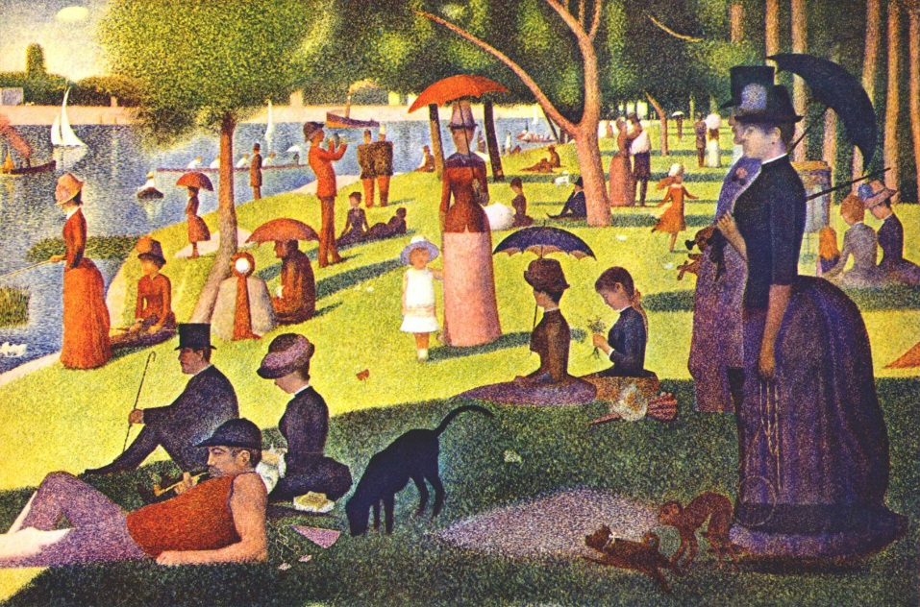
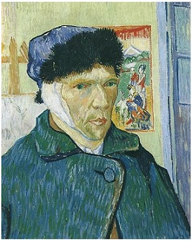
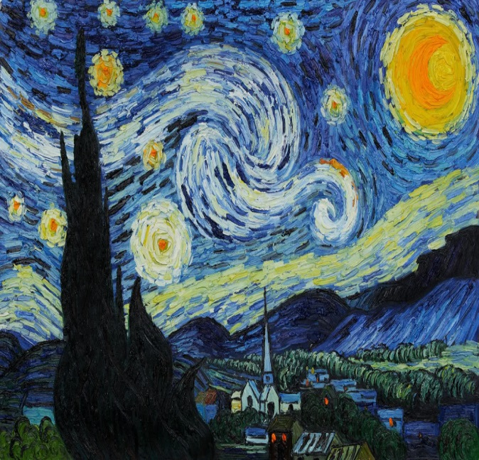
Postimpressionists
Later painters, developed a variety of styles.
Georges Seurat – arranged small dots of color to define shapes of objects.
Vincent van Gogh – experimented with sharp brush lines and bright colors. His unique brushwork lent a dreamlike quality to everyday subjects.

